Slide 1
ForeSEE
Initial Prototype

Slide 2
Project Objectives
Target audience: Parents with kids aged from 6 - 8
Objective 1: Improve parents’ accessibility of their kids’ eye data
Objective 2: Improve parents’ intuition of their kids’ eye data
Objective 3: Educate parents and kids about the importance of eye health

Slide 3
ForeSEE
A phone application that
allows users to view, record and understand eye check records
educates users with multimedia content(texts, videos and games) on how to take care of their eyes and why is it important

Slide 4
TWO potential ways to implement ForeSEE:
Features both side in one app
2. Features only patients side
Professionals’ side
Professionals can input eye check-up data with their own phone
Professionals can view patients’ check up data with their phone
Patients’ side
Patients can either enter the data themselves or ask professionals to enter the data with patient’s phone
View contact details of professionals
View records of their kids with explanation and visualization
Education materials

Slide 5
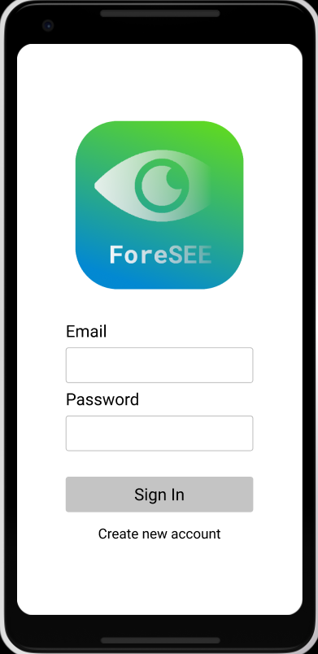
Link to our application
https://www.figma.com/proto/ZlktbEjfmNgdSW5y9lXJCF/EYE-APP-DEMO?node-id=337%3A71&scaling=scale-down
Can be opened with phone/computer browser
For computer browser, use mouse to click the buttons to go to next page, use mouse to drag left to go back to last page.
For phone browser, tap button to go to next page, swipe left to go back to last page.

Slide 6
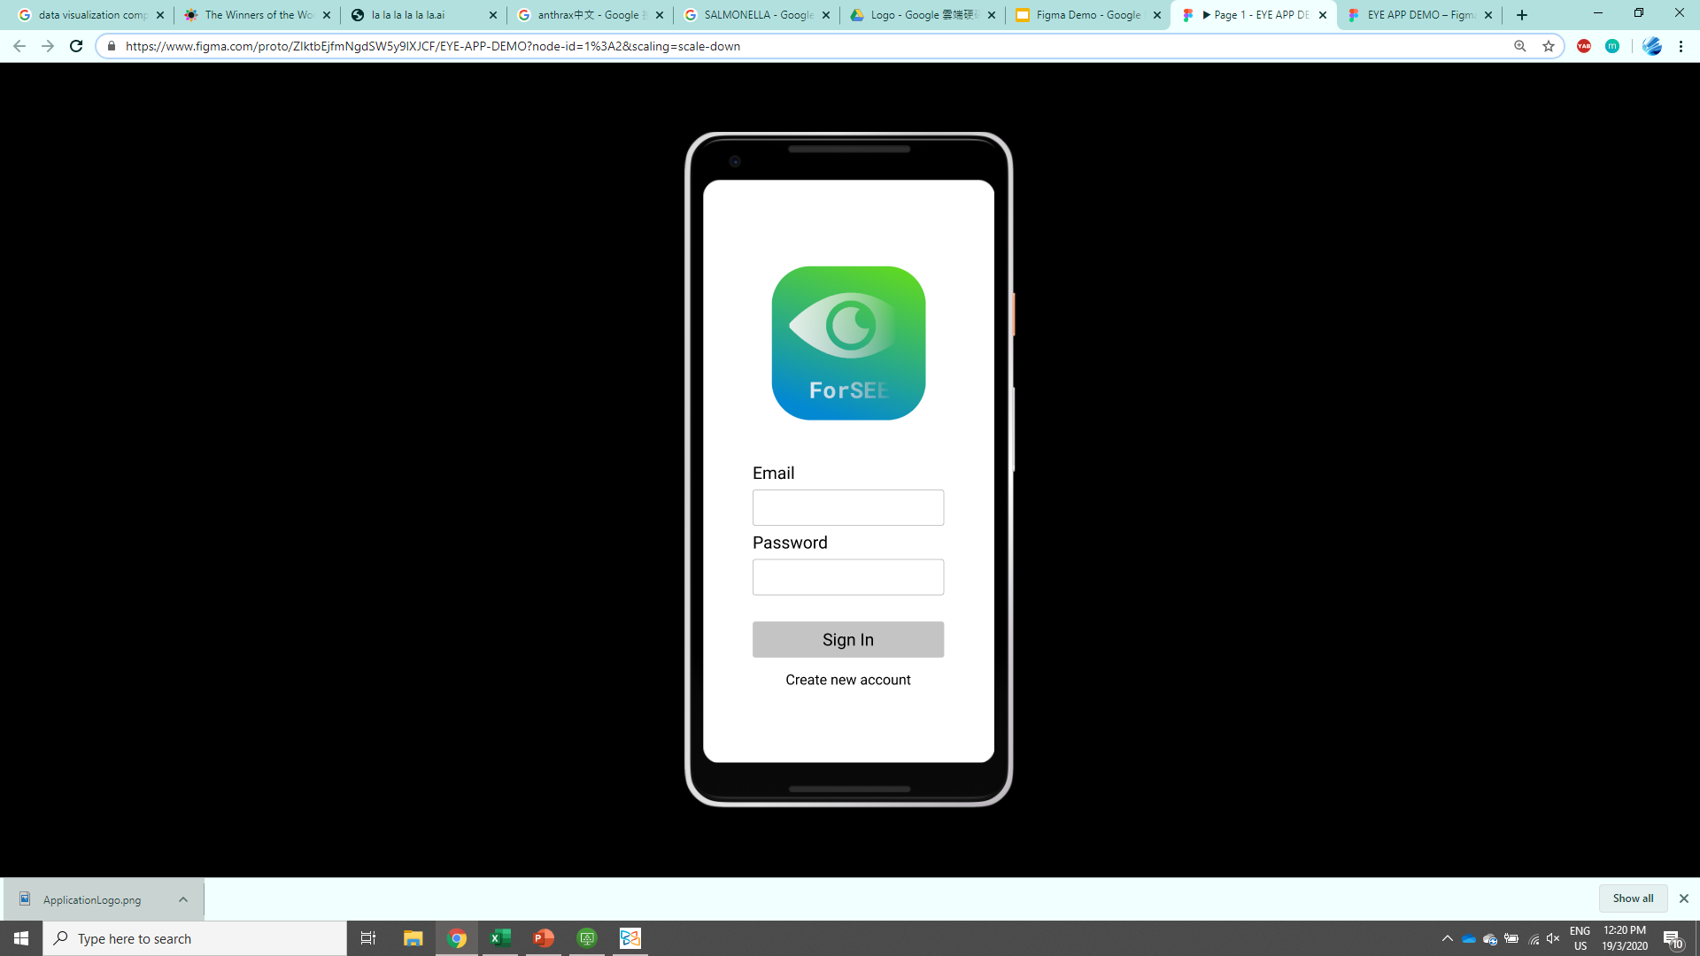
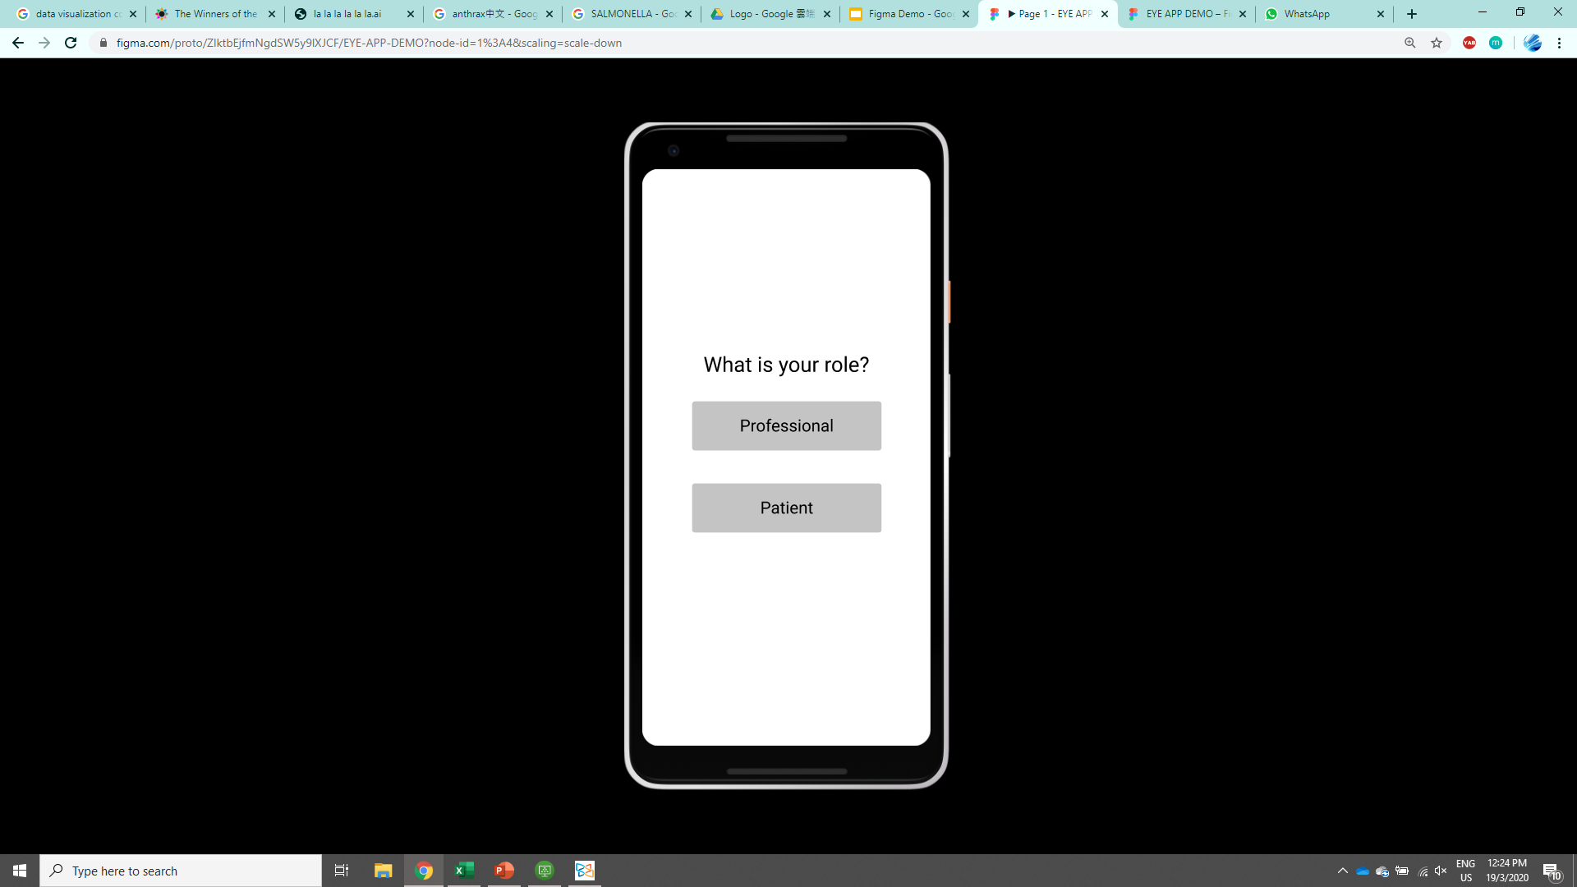
Role choosing
Click to see the professional’s side of the app
Click to see the patient’s side of the app
Click Create new account to start

Slide 7
Professionals’ side

Slide 8
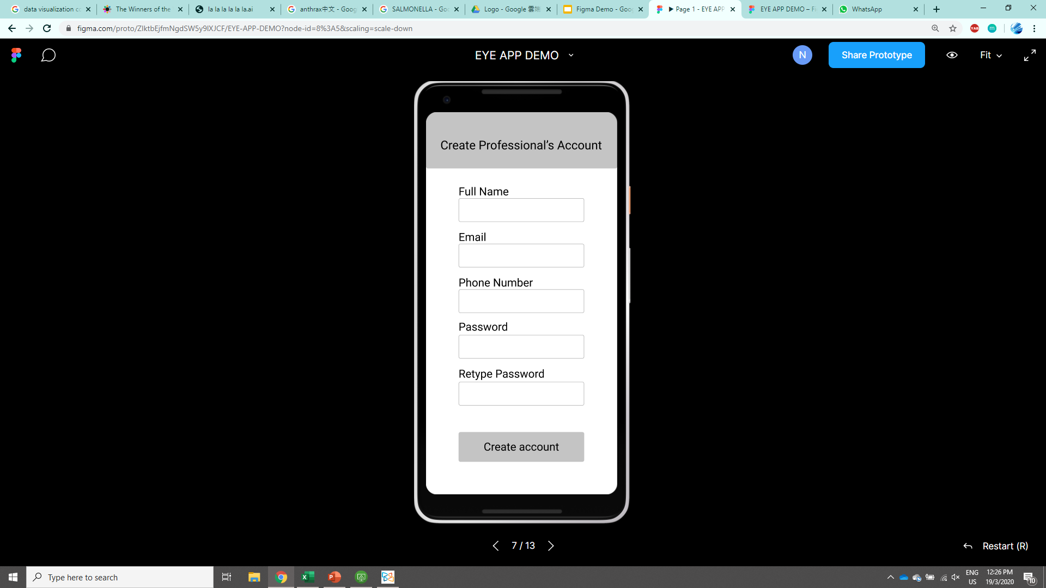
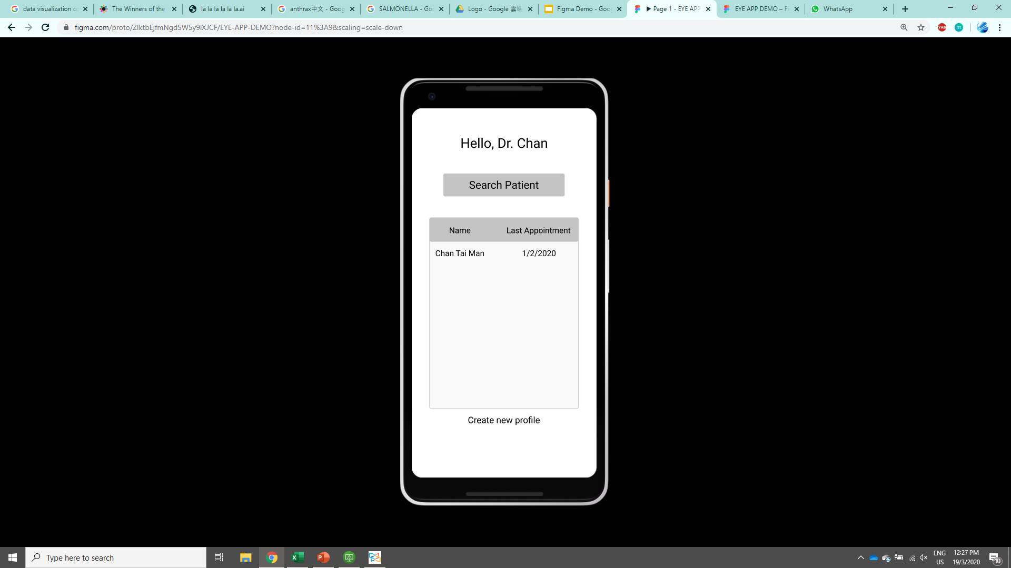
Professionals’ side - Create account & Main Menu
Use full name and phone number to search a patient profile(Not implemented in this demo)
Click to see detialed profile
Click to create a new patient profile

Slide 9
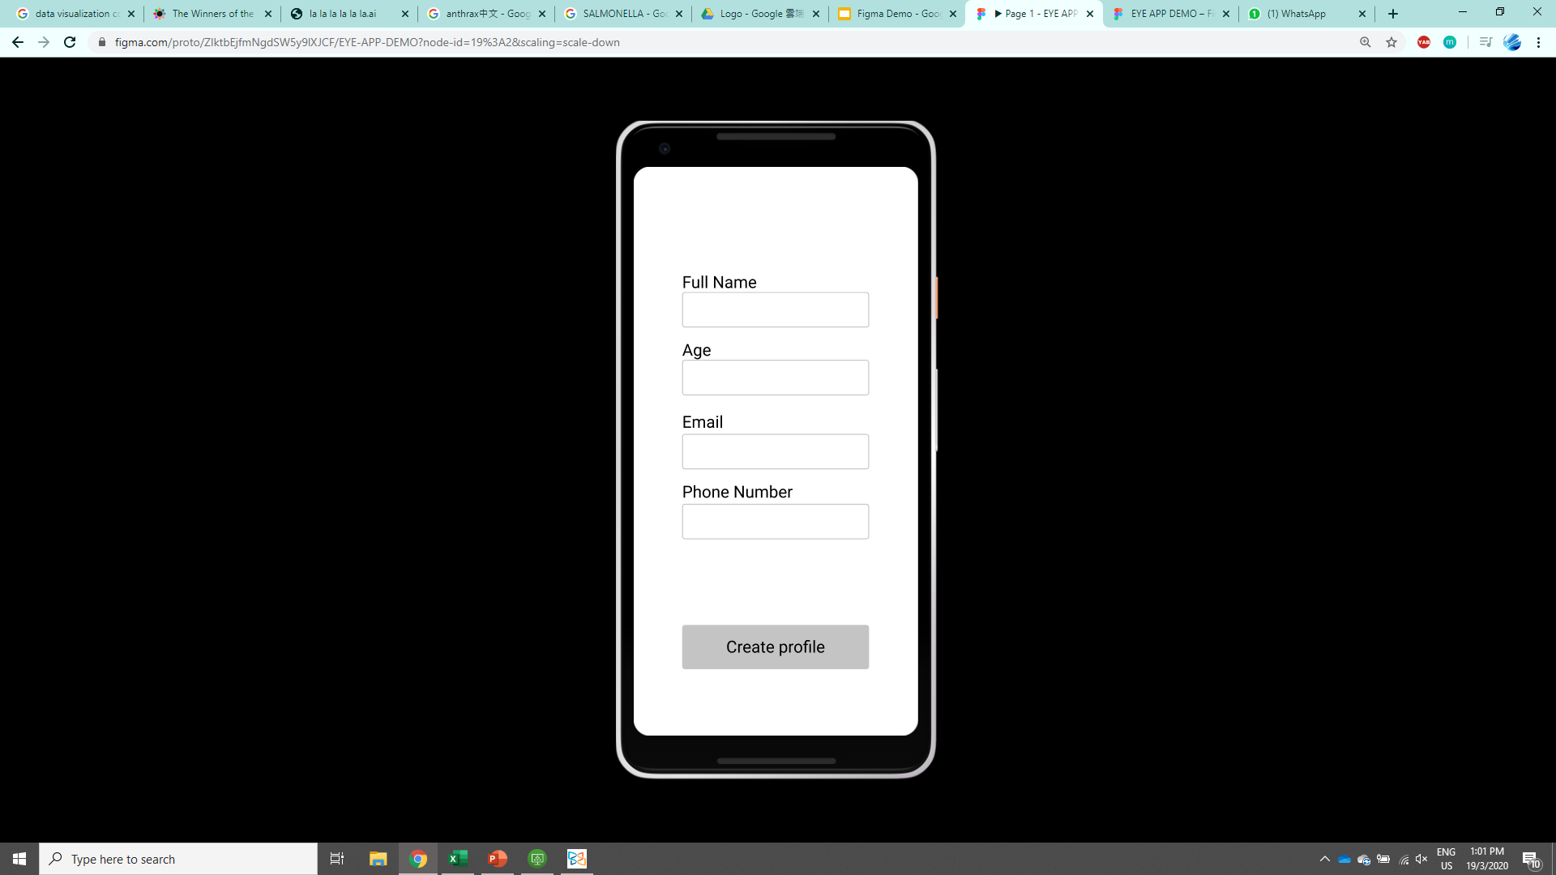

Professionals’ side - Create new profile
If age is under 18, parents’ information is needed to create the profile

Slide 10
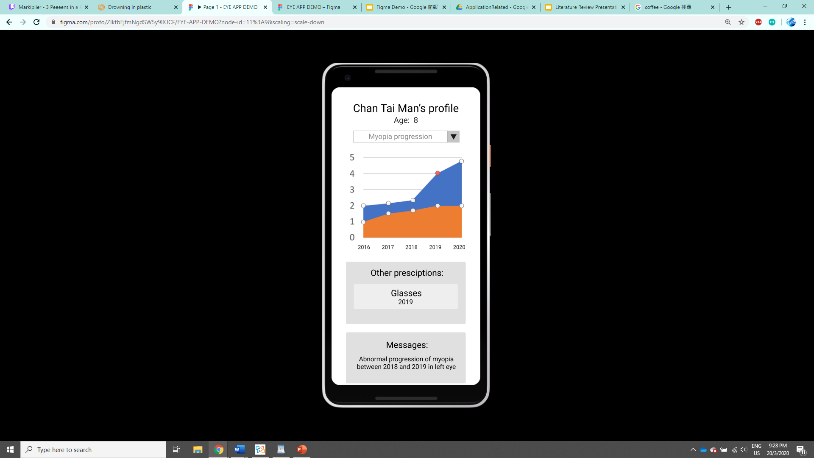
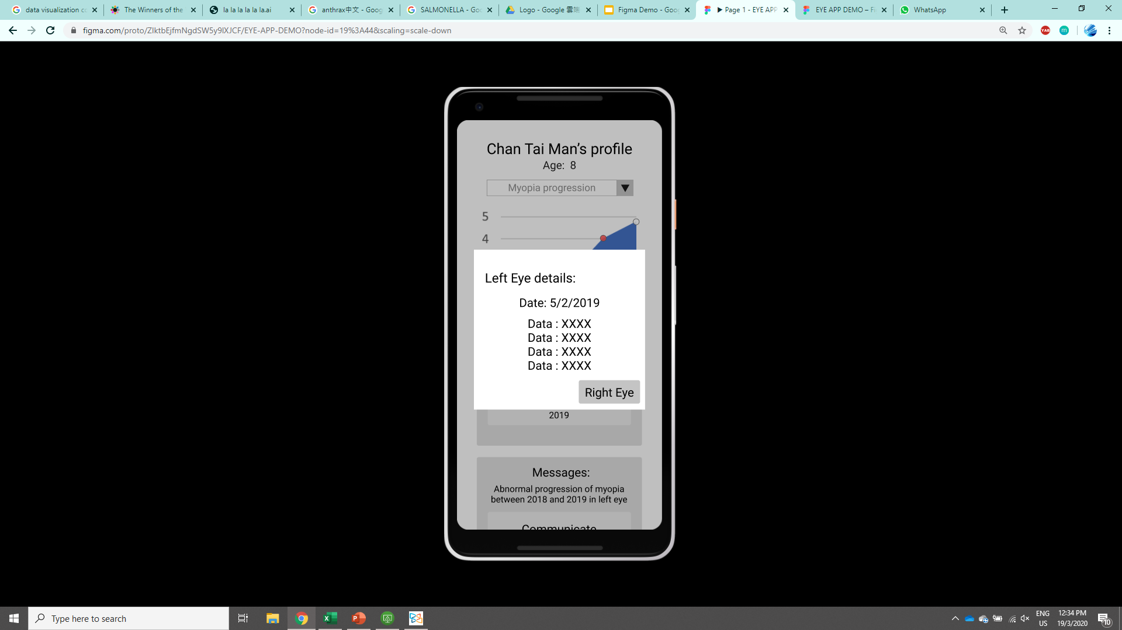
Professionals’ side - View profile
Click to switch to different prescription (hyperopia, astigmatism)
Information of the glasses of the patient can be viewed which enables checking whether the glasses suit him

Slide 11
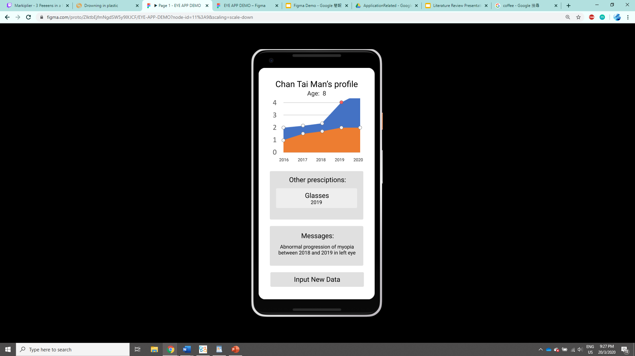
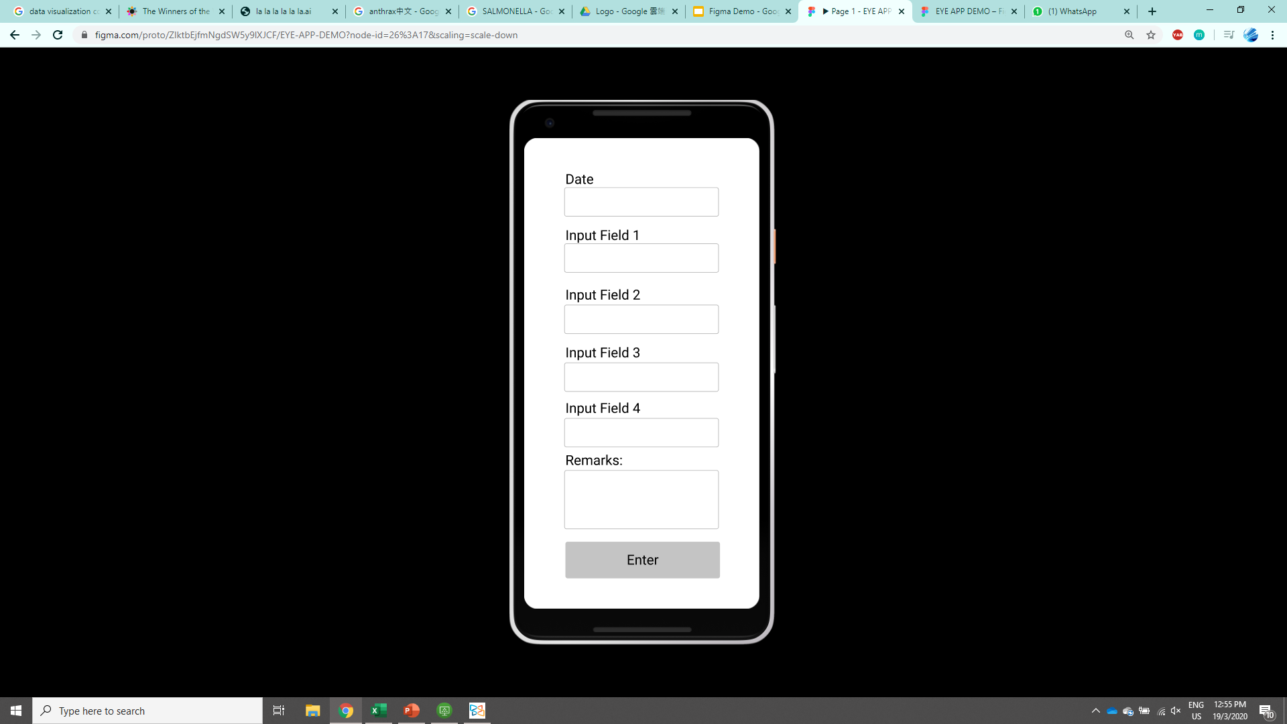
Professionals’ side - Data Input

Slide 12
Patients’ side

Slide 13
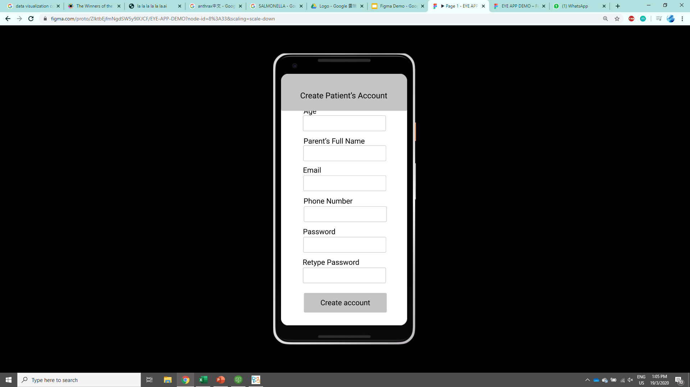
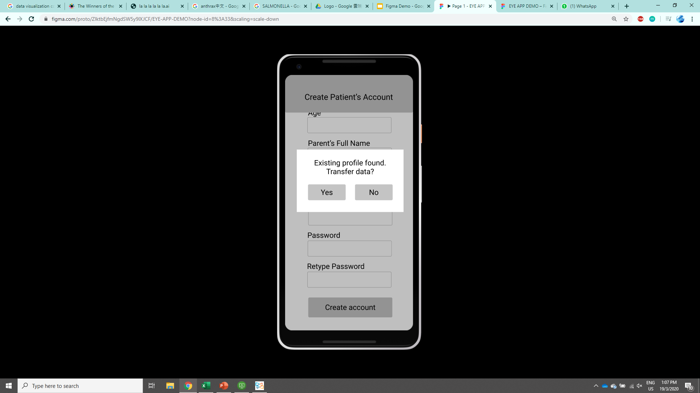
Patients’ side - Create account
If a profile is created in the professional’s side, it can be imported to the patient’s side

Slide 14
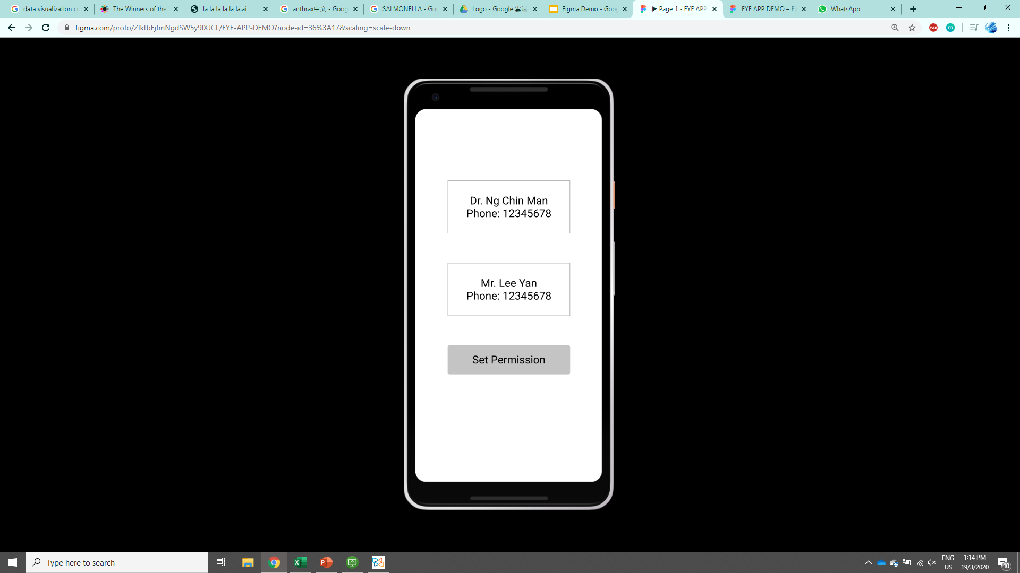
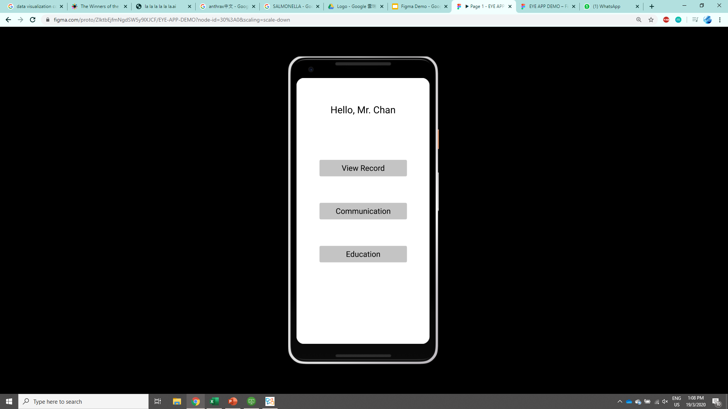
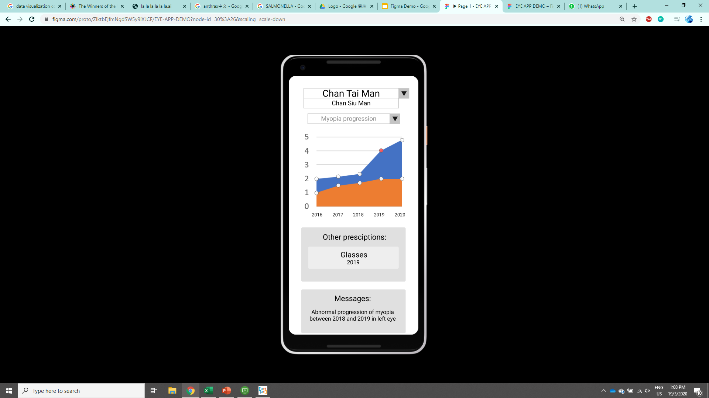
Patients’ side - Main Menu & Communication
If a profile is created in the professional’s side, it can be imported to the patient’s side
A permission of giving eye data to the professional should be done so as to prevent privacy issue

Slide 15
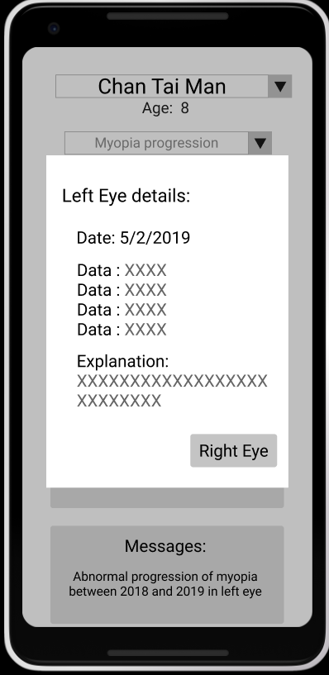
Patients’ side - View record
Switch to different sub-account(different children of under the same parent’s account)
Explanation is added in patient’s side to describe the data in understandable language

Slide 16
Data visualization methods

Slide 17
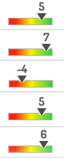
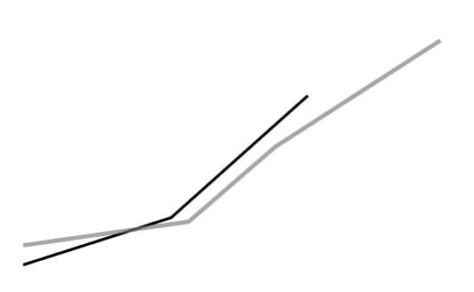
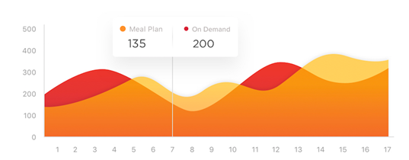
Visualization on Check-up record
Your Myopia prescription
Warning: 70% similar to people with glaucoma
Compare the current trend with some known trend of prescription with different eye diseases
Understand the rate of change of prescription
Compare to different benchmarks to understand how healthy your eyes are compared to others/certain standard
Be alerted by the possibility of potential eye diseases

Slide 18
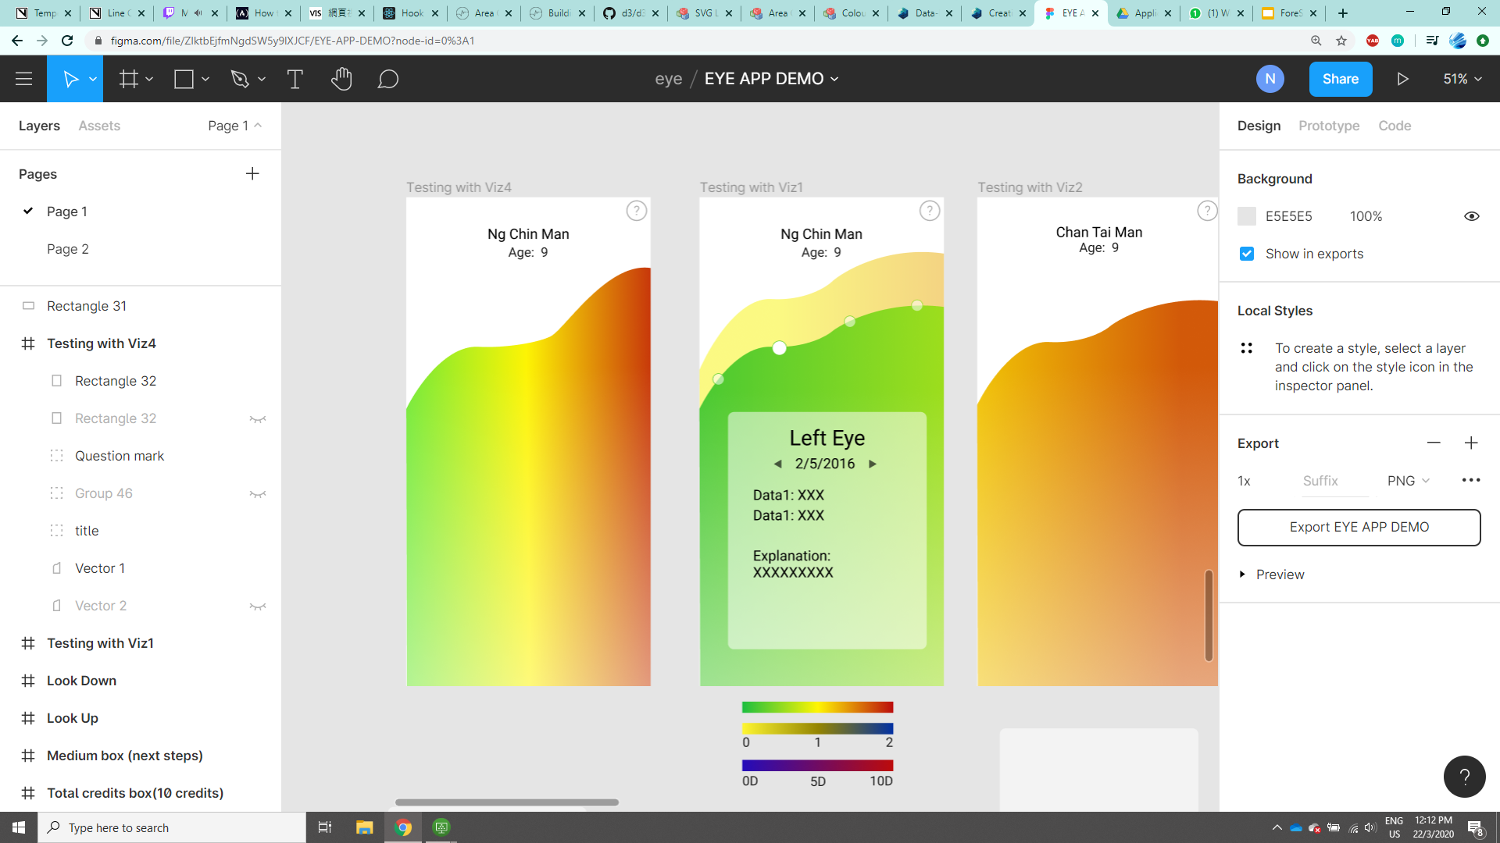
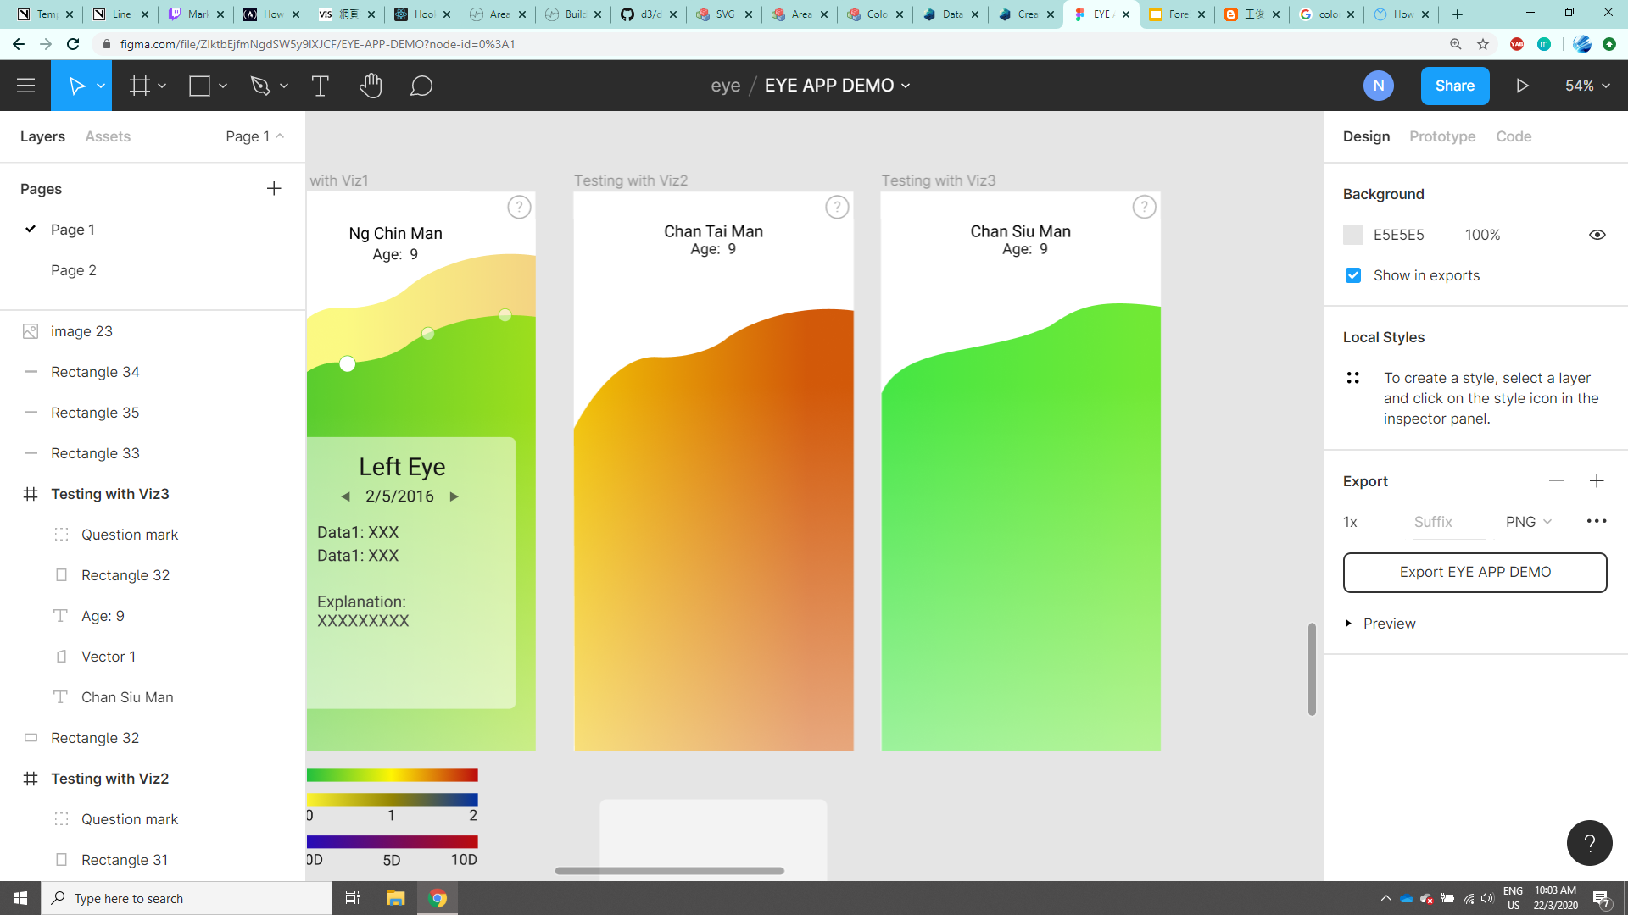
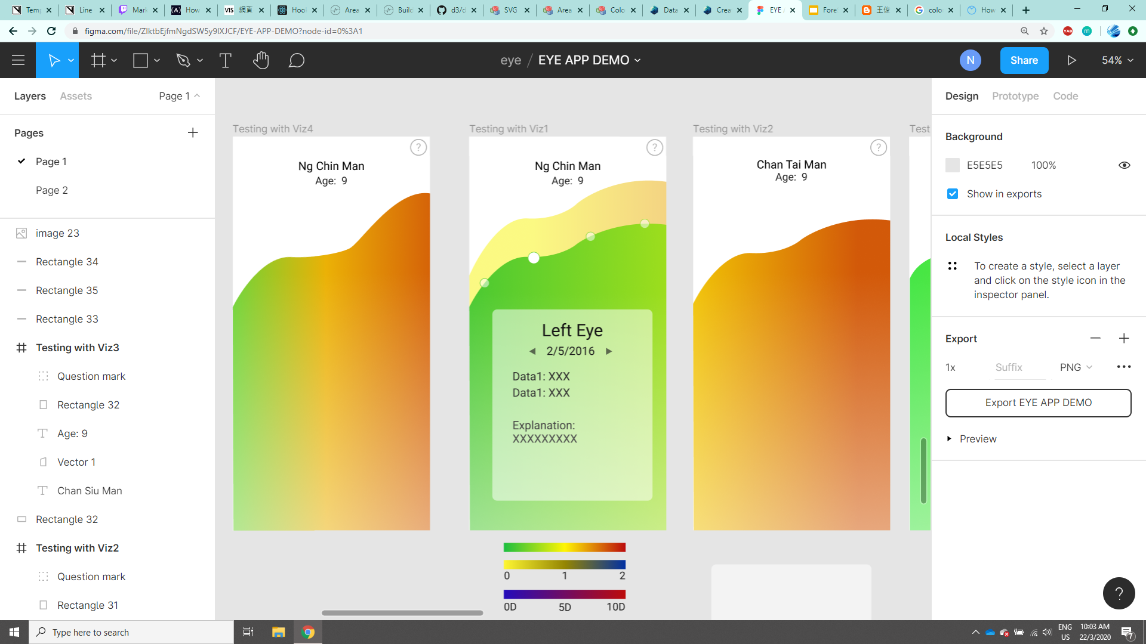
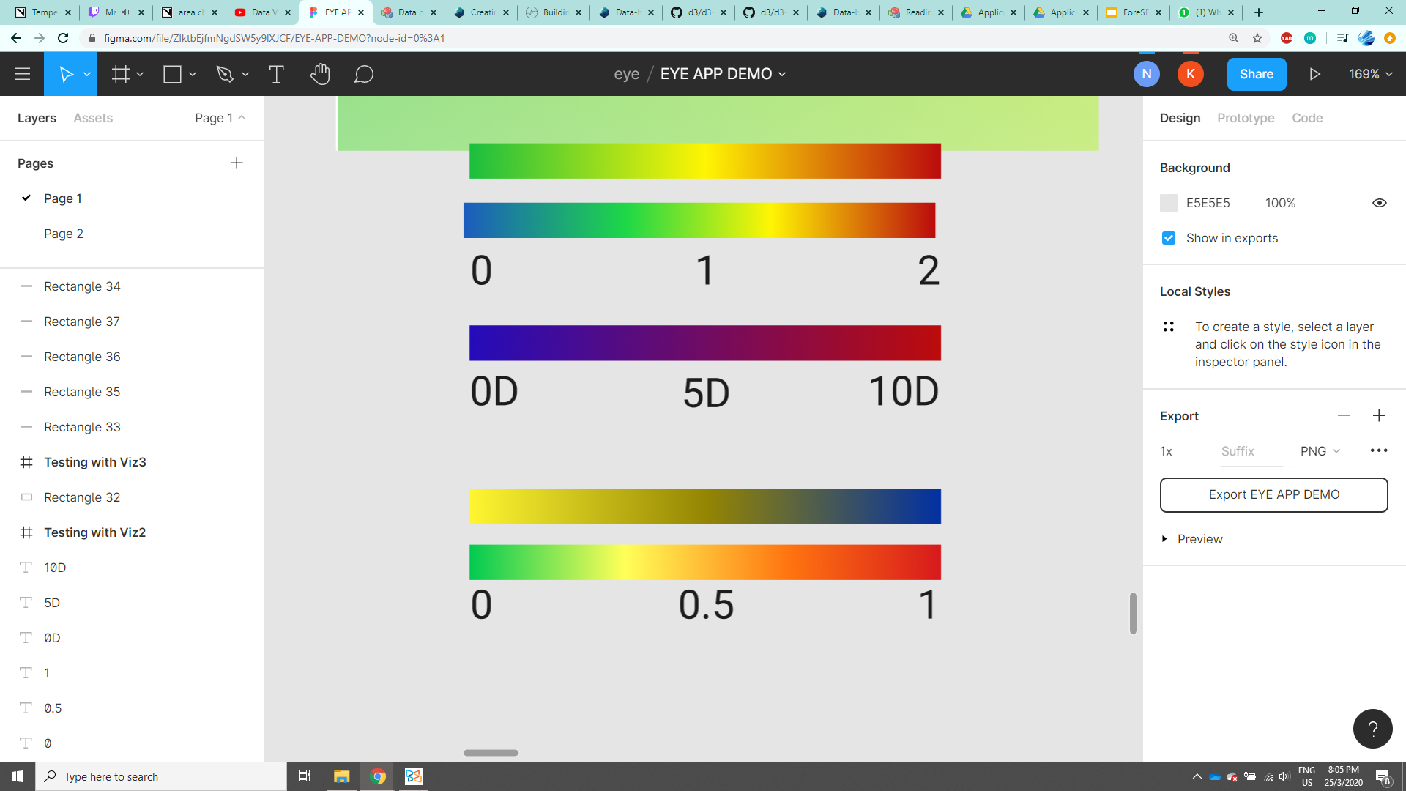
Understand records from Colour & Slope
Proposed Colour Scale(D)
For colourblinded
tutorial
explanation
Similar range of eye prescription record
Rapid change in presciption
Level of severity can be understood from the colour.
Notes:
What unit is the best?
code: https://vizhub.com/norangai/836429b2f4d4480388f1dabb740d014d?edit=files&file=index.js

Slide 19
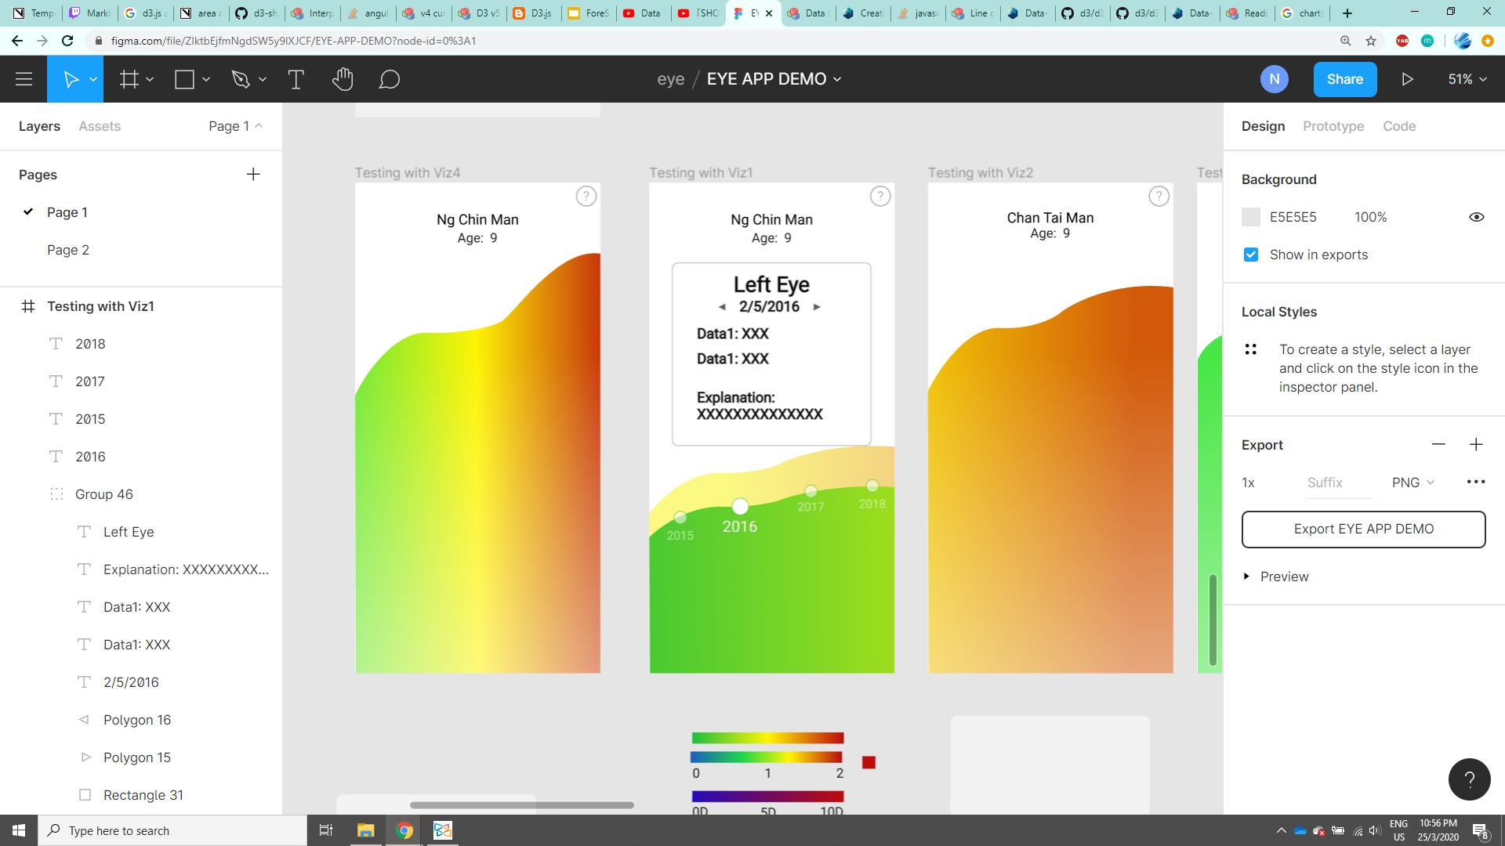
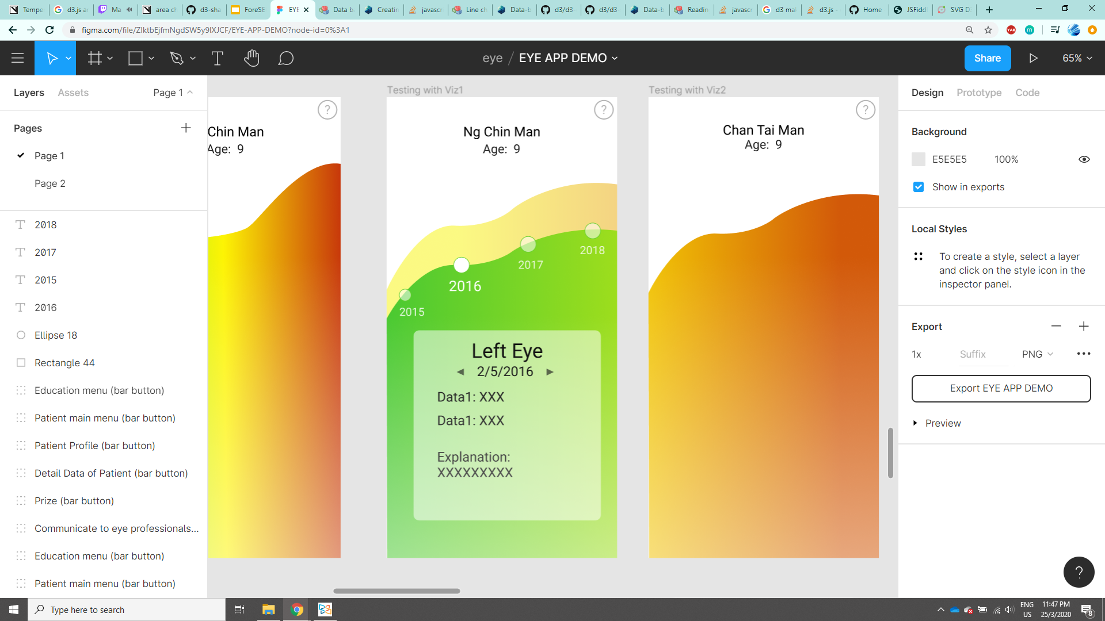
Implementation ideas
Idea 1:
Idea 2:
Users can tap on a circle to look at the detail record.
Tap outside the graph to change to another eye
Only show 4 - 5 records at a time.Scroll Horizontally to see other part of the chart. Overall trend can be shown in another page

Slide 20
Education materials

Slide 21
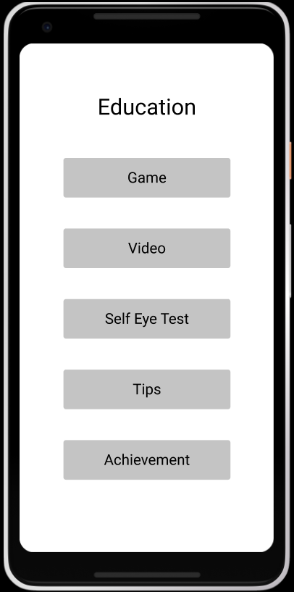
Education - Main Menu

Slide 22
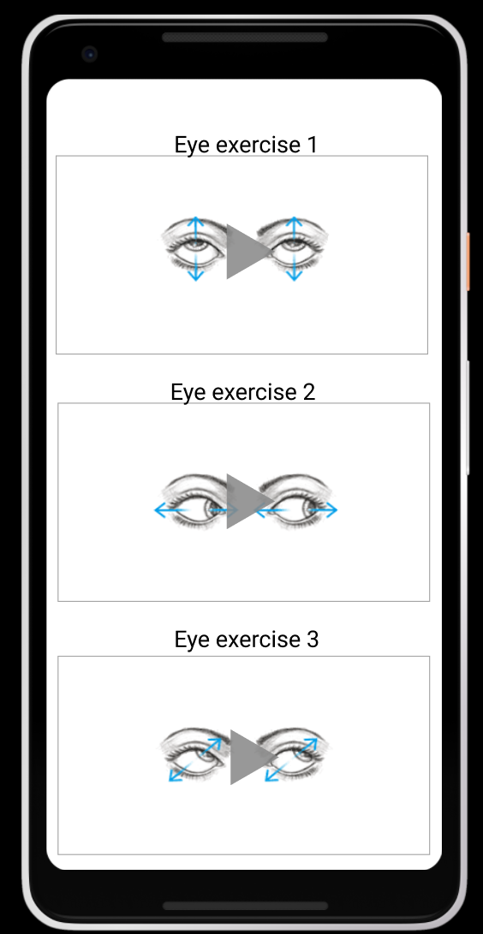
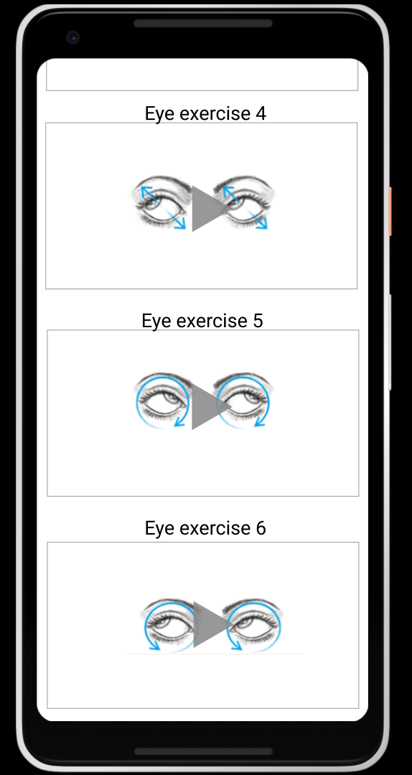
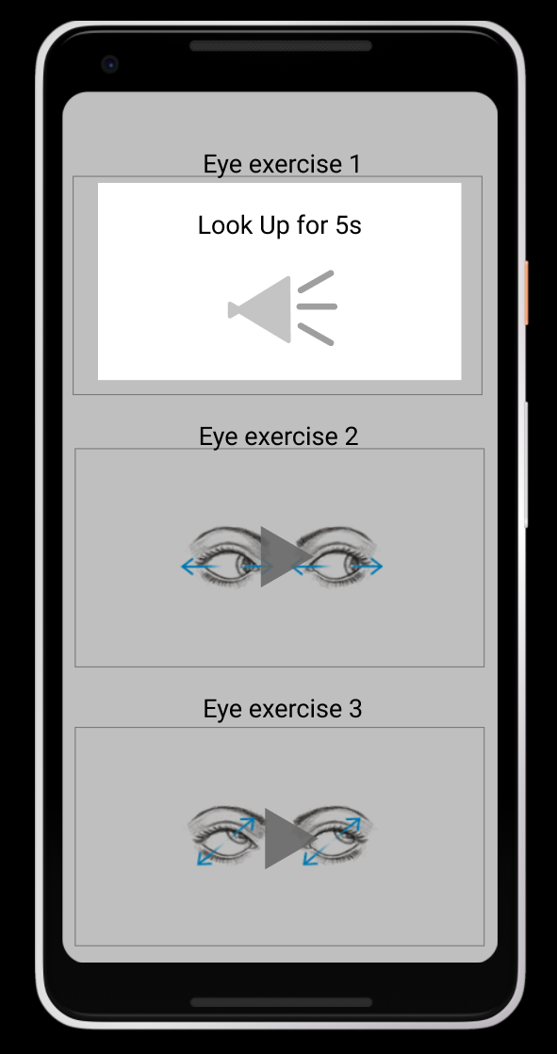
Education - Eye Exercises Video
Audio Instruction
Automatically count down for 5 seconds and change to next instruction.
Reduce screen time by asking them to look away for certain time
Notes:
https://www.figma.com/proto/ZlktbEjfmNgdSW5y9lXJCF/EYE-APP-DEMO?node-id=148%3A110&scaling=scale-down (figma demo app)
https://www.figma.com/file/ZlktbEjfmNgdSW5y9lXJCF/EYE-APP-DEMO?node-id=0%3A1 (figma job creation web)

Slide 23
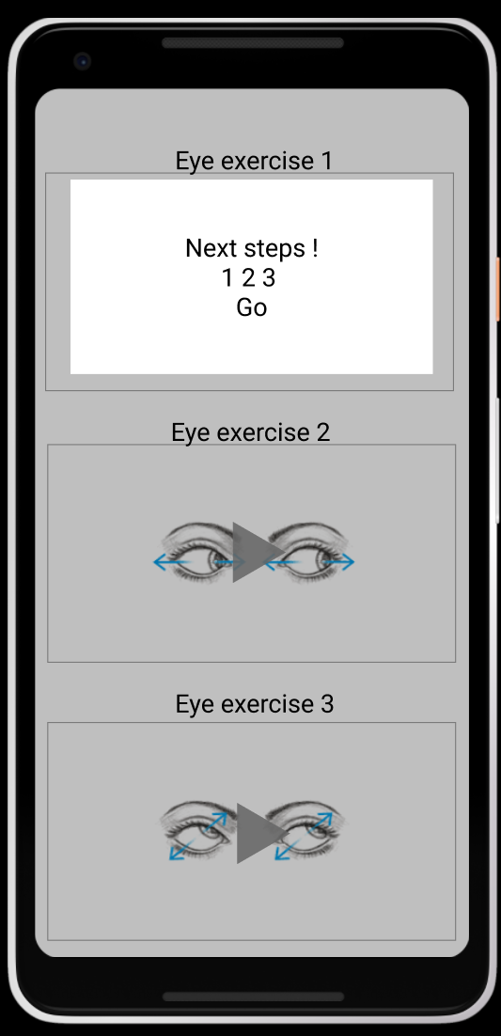
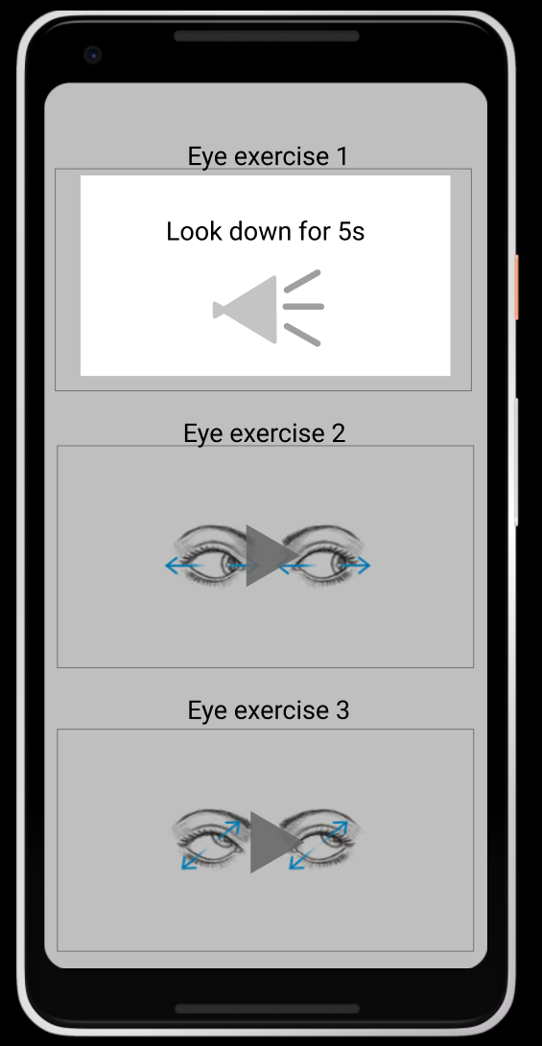
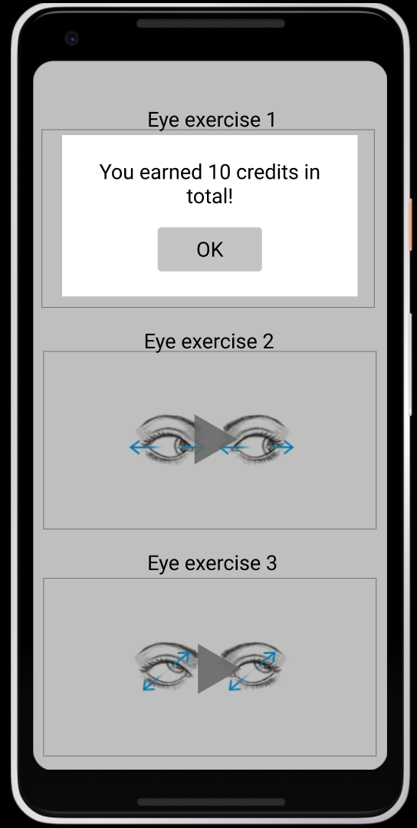
Education - Eye Exercises Video
Finish the exercise to earn credits that can be used in the achievement page

Slide 24
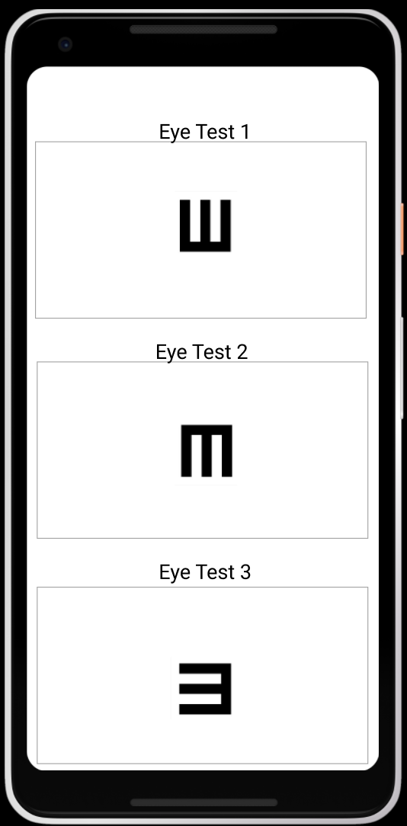
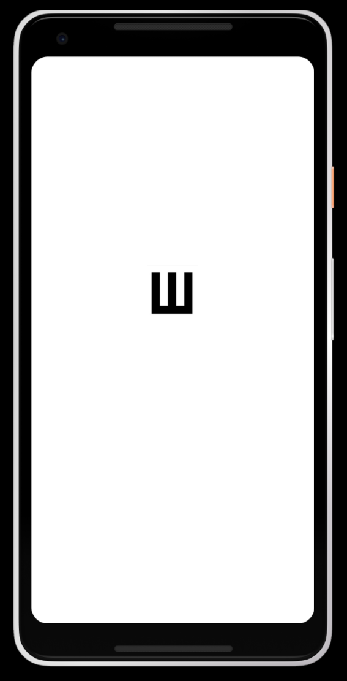
Education - Self Eye Test
Ask the patient to tell you the direction
Eye examiner:
swap the direction that is told by the patient
Patient: upward
Eye examiner:
swap from bottom to the top → back to the eye test menu

Slide 25
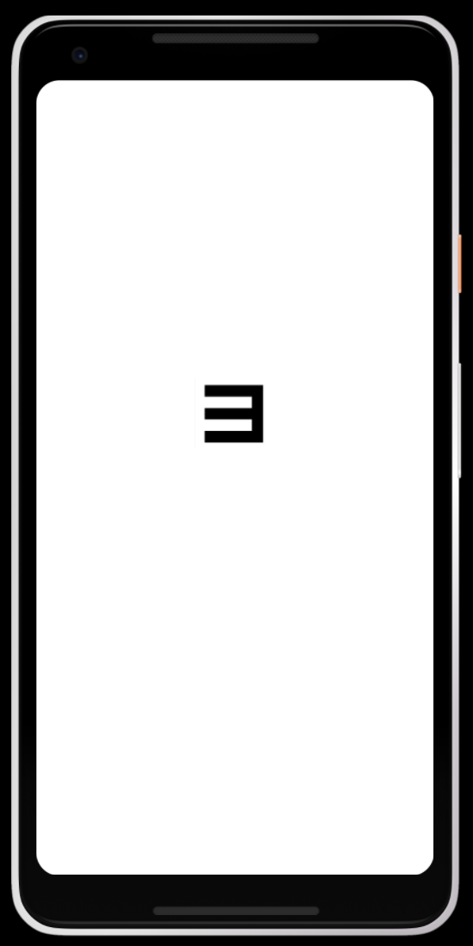
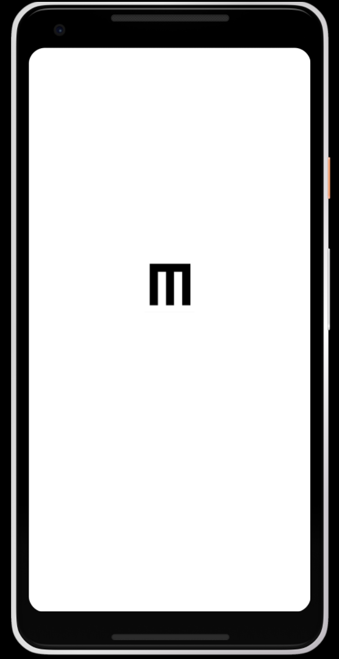
Education - Self Eye Test
Ask the patient to tell you the direction
Eye examiner:
swap the direction that is told by the patient
Patient: left hand side
Eye examiner:
swap from right to the left → back to the eye test menu
Ask the patient to tell you the direction
Eye examiner:
swap the direction that is told by the patient
Patient: downward
Eye examiner:
swap from top to the bottom → back to the eye test menu

Slide 26
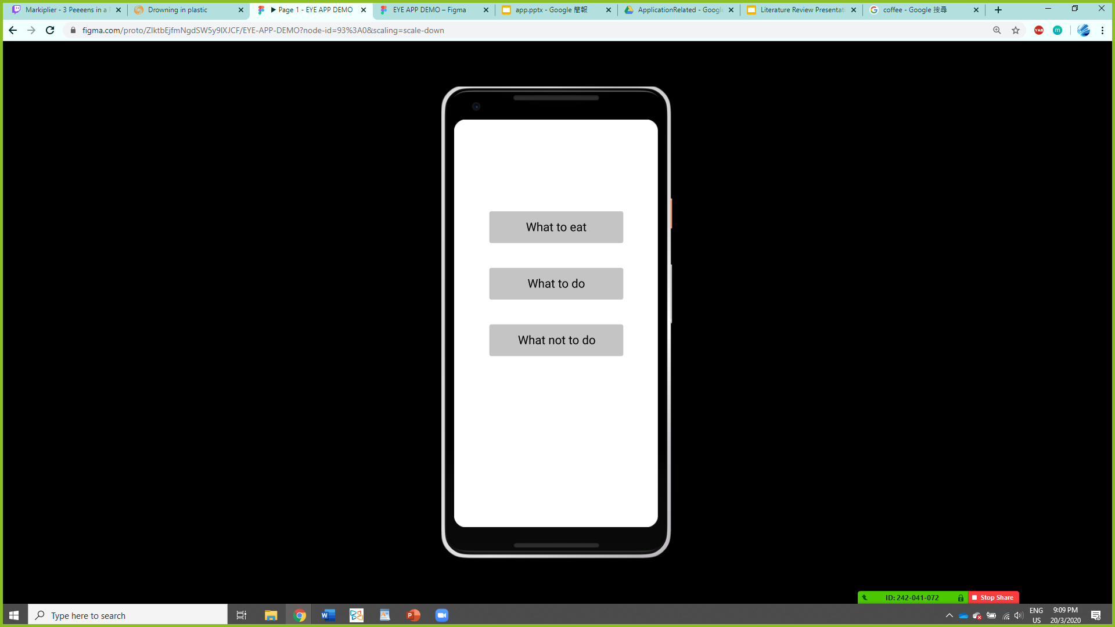
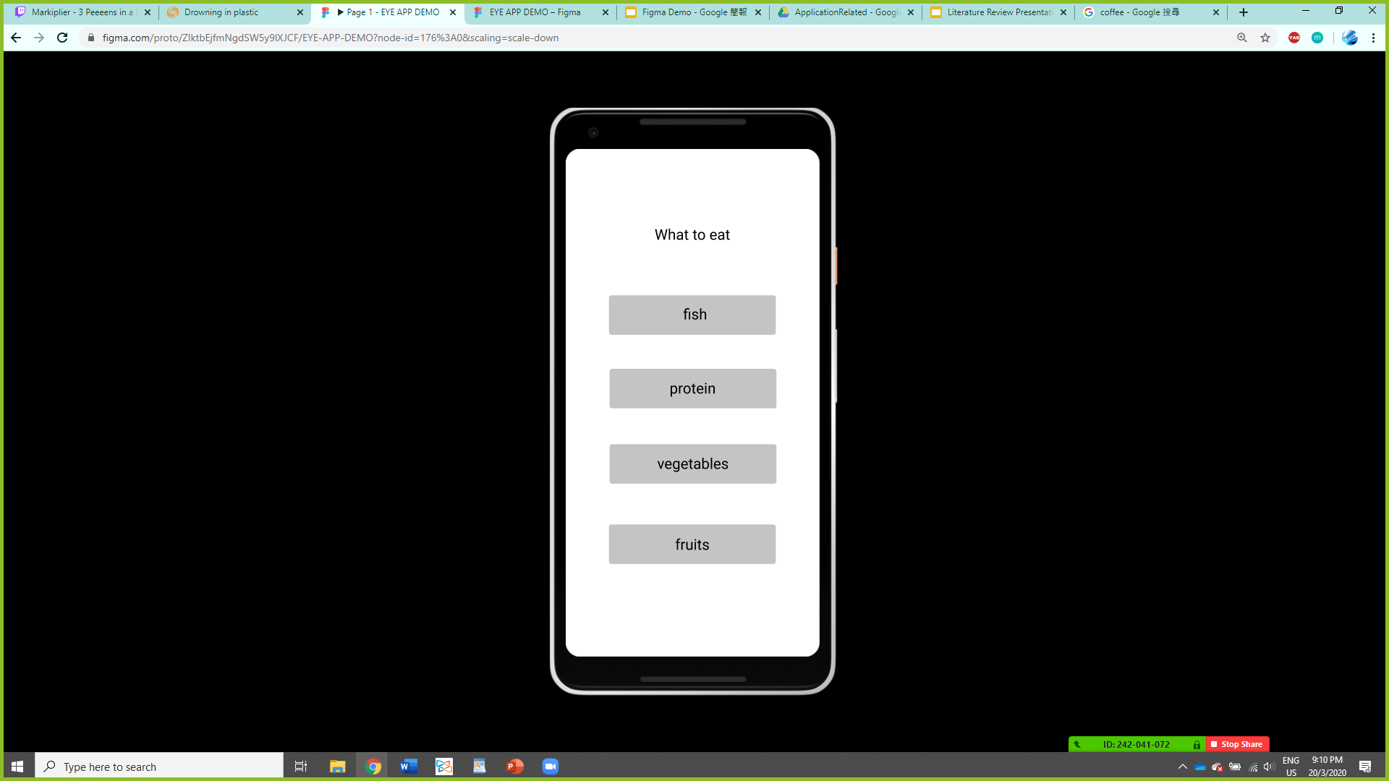
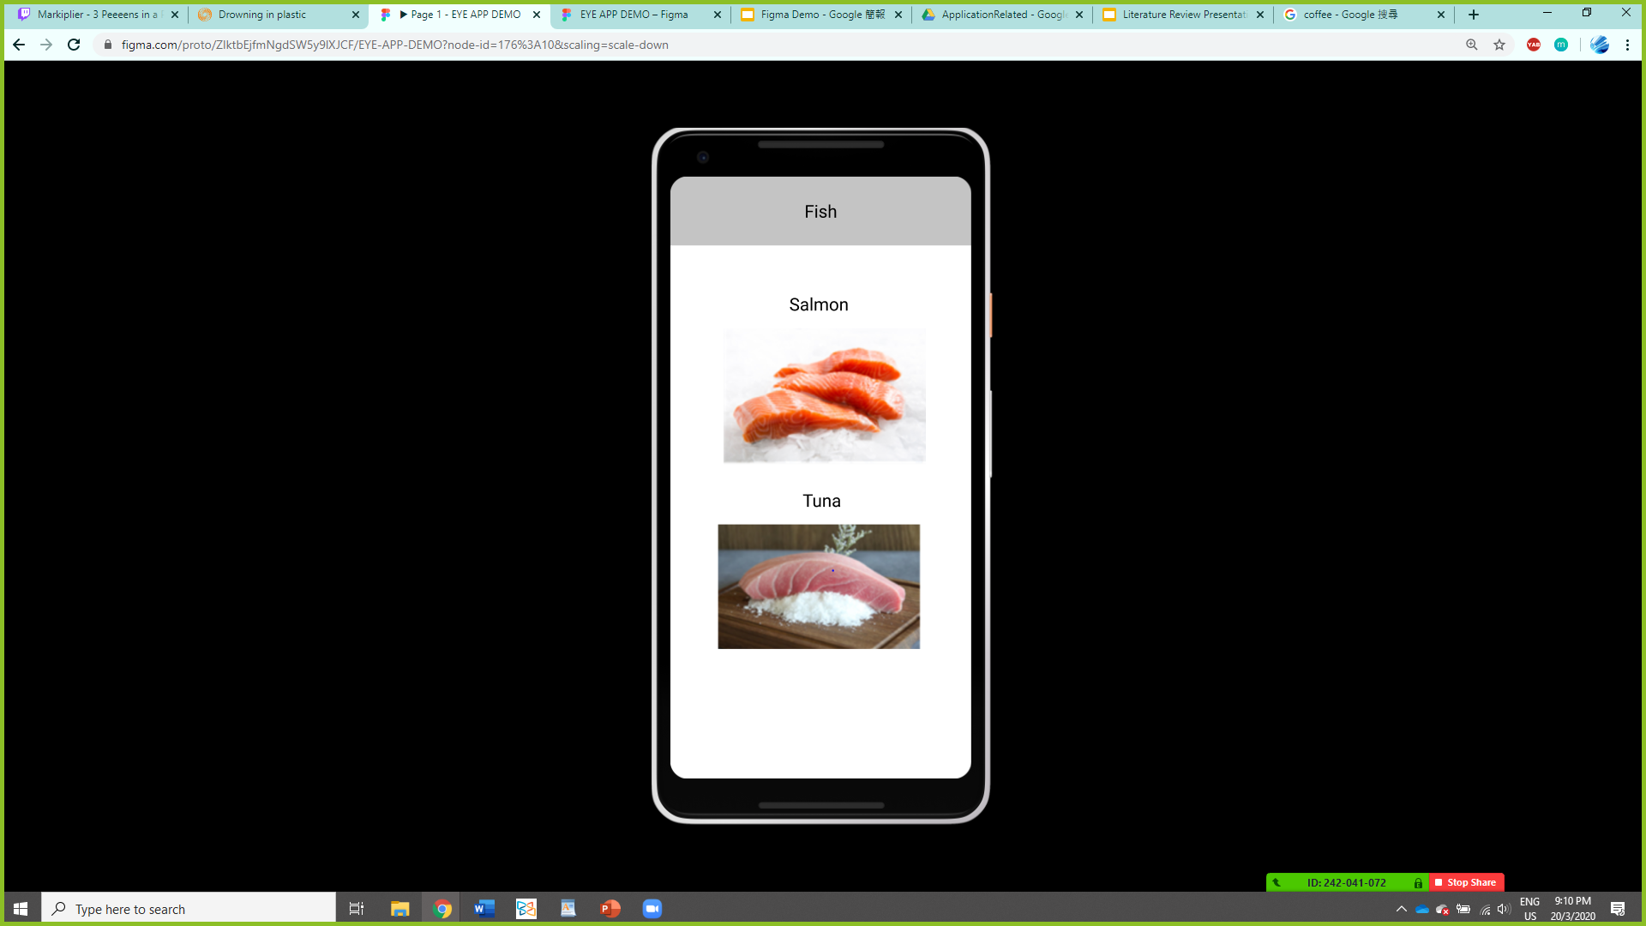
Education - Tips
Provide some general advices on how to take care of your eyes

Slide 27

Education - Game
How to destroy your eyes within 1 minute
Play
How to play
Accomplishment

Slide 28
How to destroy your eyes within 1 minute
Play
click
How to play
Accomplishment

Slide 29
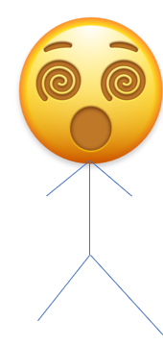
Once upon a time, there’s an evil professor who had an evil dream…
background story

Slide 30
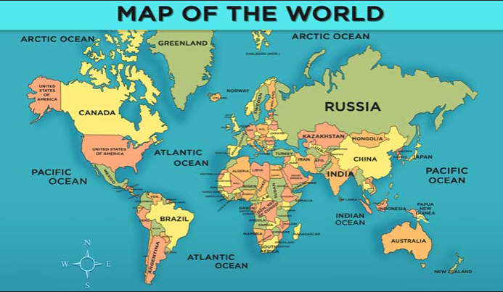

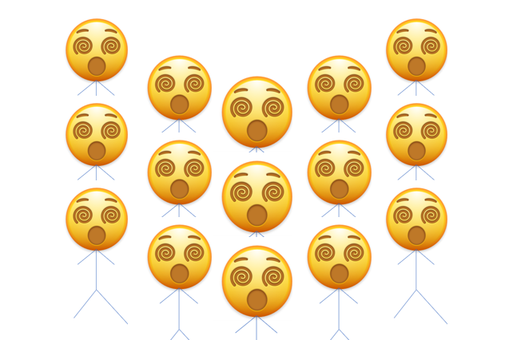
He wanted to make everyone suffering from myopia

Slide 31
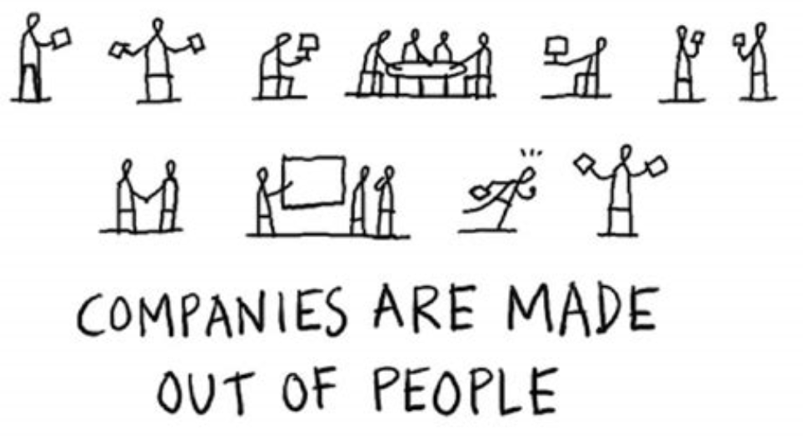

You
You were invited to be part of his team

Slide 32




Your job is to help making everyone on this planet suffering from myopia
You

Slide 33

That’s how the story started…

Slide 34

Name your case
Case:
Type in ‘Dancing Monkey’

Slide 35

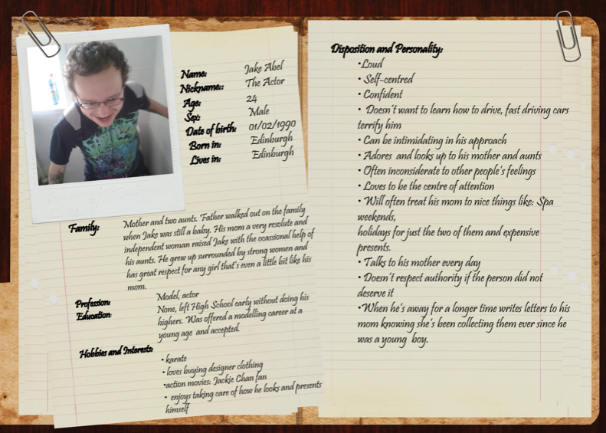
Case: Dancing Monkey
Target’s Name: JOHN
Initial Myopia Degree:300
Eye Health condition:
(if any)
Random target will be generated according to the patient’s eye data(the patient’s data will be import to the game automatically)

Slide 36
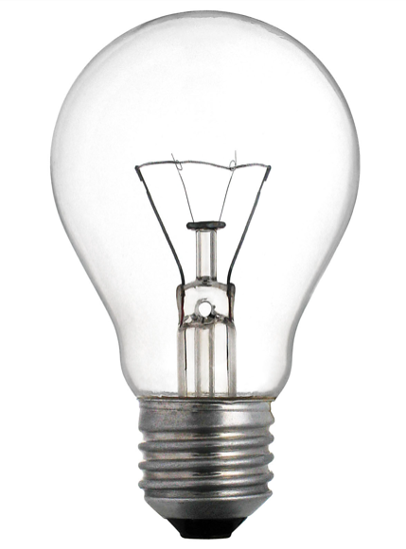



Age
10
12
14
16
18
20
John
Indication on Myopia progression(through colour& numbers)
Age of the target
(progress with time)
Evolve points to upgrade(will explain in later slides)
click
Evil Plans
Pts:1

Slide 37
Evil Plans
Use evolve points to intrigue different bad behaviours in using eyes(which will worsen myopia progression)
Behaviour
Environment
Long screen time
click
Lack of outdoor exercise

Slide 38

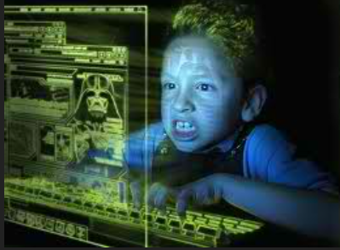
Age
The age increases as the time progress
10
12
14
16
18
20
John
Indication on Myopia progression(through colour& numbers)
Evil Plans
Pts:13

Slide 39

Age
10
12
14
16
18
20
John
As the game proceeds, the target are now suffering from high myopia
Evil Plans
Pts:15

Slide 40

Congrats
You have complete your mission and turn the target to suffer from myopia within XXX days!!!

Slide 41
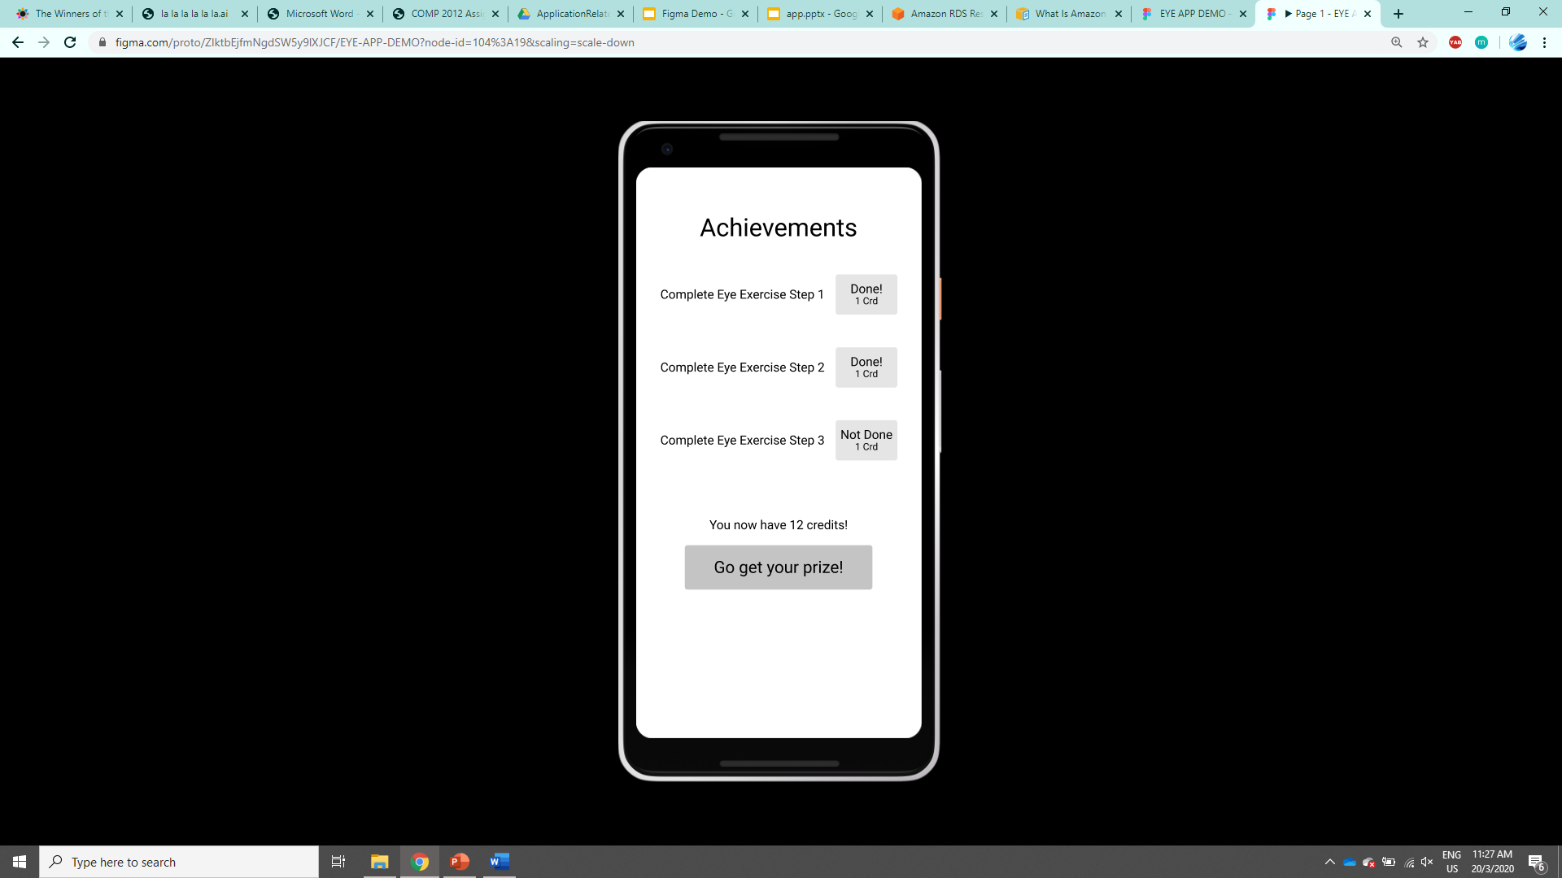
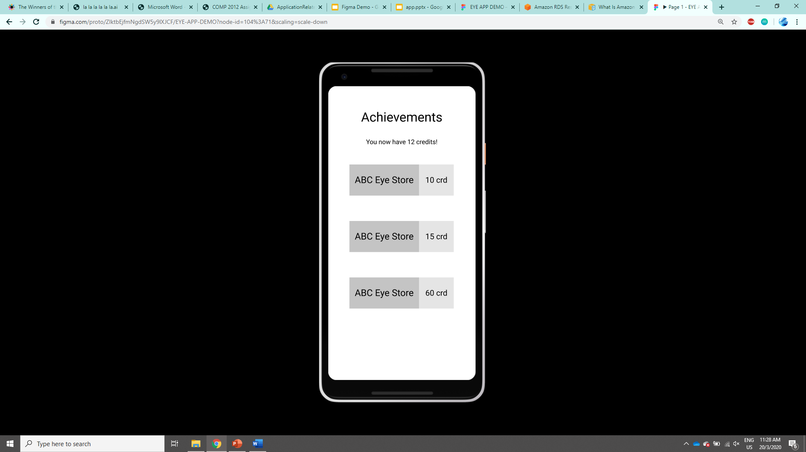
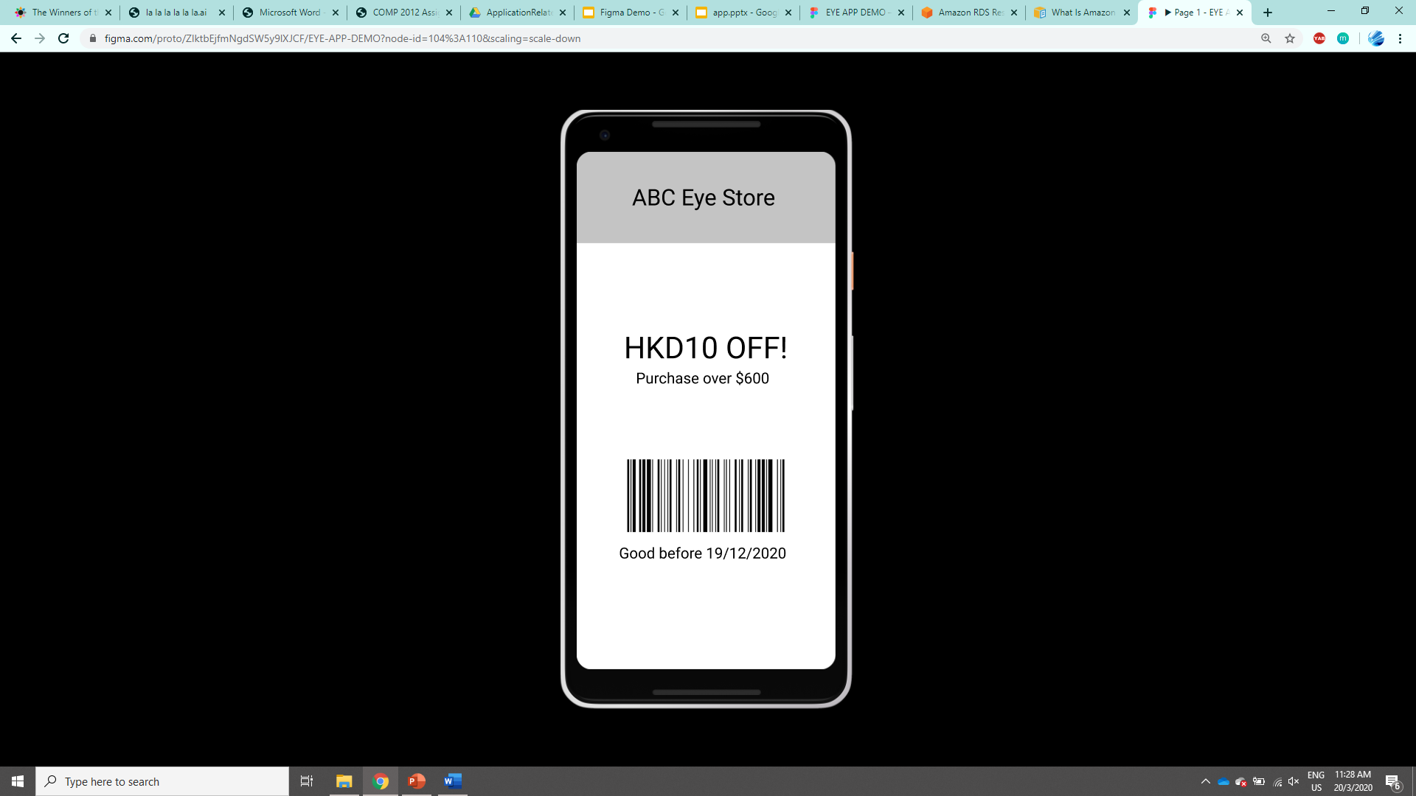
Education - Achievement Page
The credits earned from games can be exchanged for digital coupons

Slide 42
Targeted behavioral changes:
Reduce screen time
Do eye exercises regularly
Go to do eye check up regularly
Follow the tips

Slide 43
How to collect User Feedback:
Set up a booth in eye hospital to promote the app
Put questionnaire in the app to ask parents to evaluate the behavioral changes of themselves/their kids
Ask professionals(maybe volunteers at the eye hospital or other opticians that we could find) to test our app

